Slide 1
Engineering Economy
Chapter 12: Probabilistic Risk Analysis

Slide 2
The objective of Chapter 12 is to discuss and illustrate several probabilistic methods that are useful in analyzing risk and uncertainty associated with engineering economy studies.

Slide 3
Decision making is fraught with risk and uncertainty.
Decisions under risk are those where the decision maker can estimate probabilities of occurrence of particular outcomes.
Decisions under uncertainty are those where estimates of probabilities of the several unknown future states cannot be estimated.

Slide 4
Four major sources of uncertainty are present in engineering economy studies
Possible inaccuracy of cash-flow estimates
The type of business involved in relation to the future health of the economy
The type of physical plant and equipment involved
The length of the study period used in the analysis

Slide 5
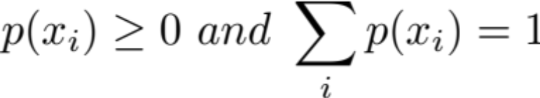
Factors such as revenues, costs, salvage values, etc., can often be considered random variables.
For discrete random variables X, the probability X takes on any particular value x_{i} is
where

Slide 6
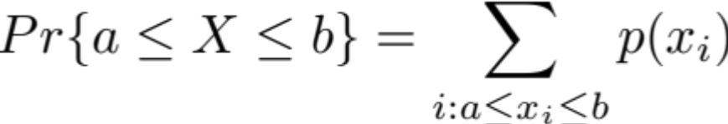
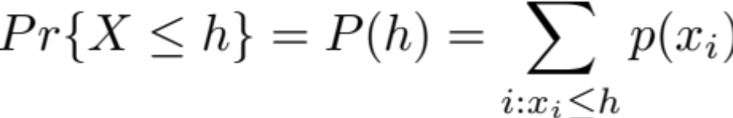
Some other properties of discrete random variables.
Probability mass function
Cumulative distribution function

Slide 7
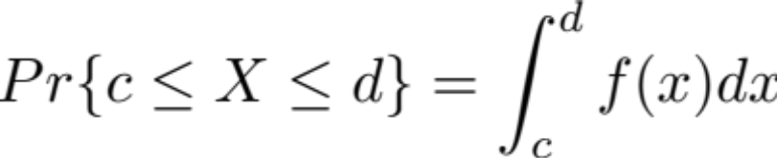
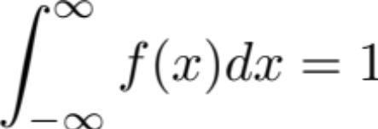
For continuous random variables…
The probability that X takes on any particular value is 0.

Slide 8
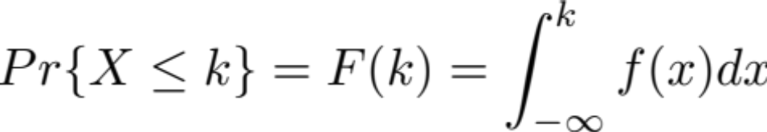
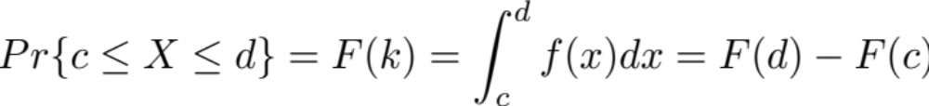
The cumulative distribution function (CDF) is
which leads to

Slide 9
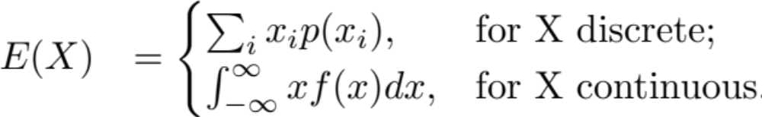
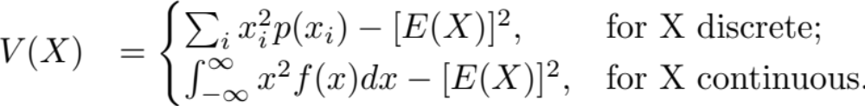
The expected value (mean, central moment), E(X), and variance (measure of dispersion), V(X), of a random variable X, are

Slide 10

Some properties of the mean and variance.

Slide 11
Acme manufacturing has installed a much-needed new CNC machine. The initial investment in this machine is $180,000 and annual expenses are $12,000. The life of the machine is expected to be 5 years, with a $20,000 market value at that time. Acme’s MARR is 10%. Possible revenues follow the probabilities given below.
Revenue | Probability
$35,000 | 0.1
$44,000 | 0.3
$50,000 | 0.4
$60,000 | 0.2

Slide 12
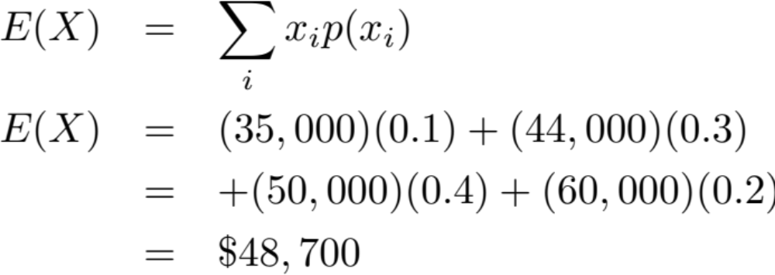
What are the expected value and variance of Acme’s revenue?

Slide 13
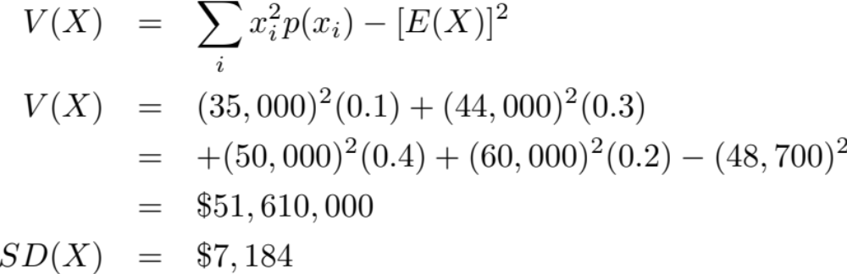
What are the expected value and variance of Acme’s revenue?

Slide 14
Pause and solve
Acme is considering purchasing a new vision system for their production line. The vision system would allow them to increase revenue due to improved quality and therefore reduced warranty expense. The initial cost of the system is $220,000, and the annual increase in net revenue is $45,000. Acme’s MARR is 15%. However, the life of the system is uncertain, with the probability of different asset lives in the following table. Given this information, should Acme purchase the vision system?
Useful life, years (N) | 8 | 9 | 10 | 11 | 12 | 13 | 14
p(N) | 0.10 | 0.15 | 0.25 | 0.20 | 0.20 | 0.05 | 0.05

Slide 15
Probability tree diagrams can display prospective cash flows, and their respective probabilities that occur in each time period.
End-of-Year
0
1
2
0.4
$1,100
0.3
0.6
$900
$750
-$2,000
0.4
0.5
$1,000
0.5
$800
$700
0.3
0.7
$825
0.3
$700
$625

Slide 16
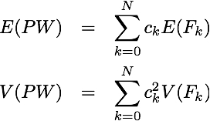
Continuous random variables present special challenges, and special opportunities.
Two frequently used assumptions are
  cash-flow amounts are distributed according to a normal distribution, and
  cash flows are statistically independent.
Thus, if
then

Slide 17
Apply these concepts to cash flows over time to fine the expected PW, and SD of PW, for the expected values and standard deviations in the table below. (Use i=8%.)
End of Year,k | Expected Value of Net Cash Flow, F_{k} | SD of Net Cash Flow, F_{k}
0 | -$10,000 | $0
1 | $4,000 | $400
2 | $4,000 | $600
3 | $5,000 | $650

Slide 18
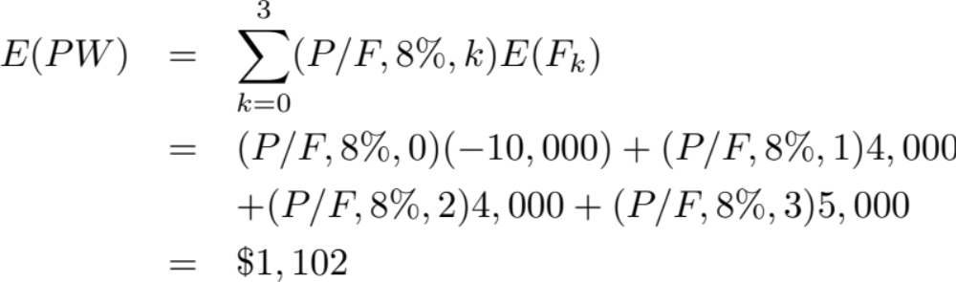
For the expected PW.

Slide 19
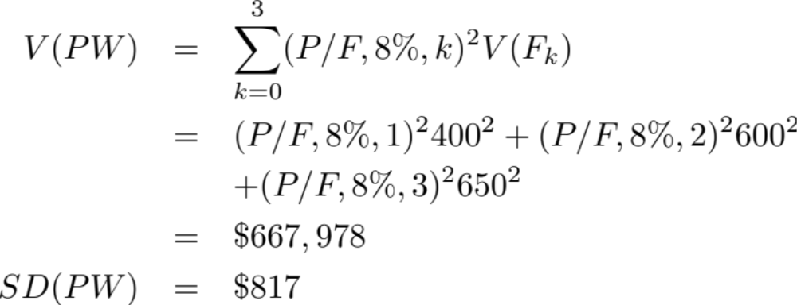
For V(PW) and SD(PW)

Slide 20
With our estimates of cash flow variables, and using the normal distribution, we can find the probability of events about the random variable occurring. For instance, in the previous example, what is the probability that the PW of the cash flows is positive? Recall

Slide 21
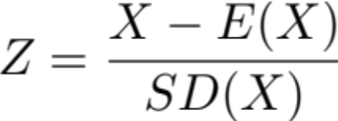
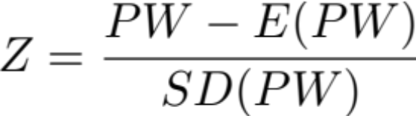
The standard normal (mean=0 and standard deviation=1) variable, Z, is defined as
For our problem, since our random variable is present worth,

Slide 22
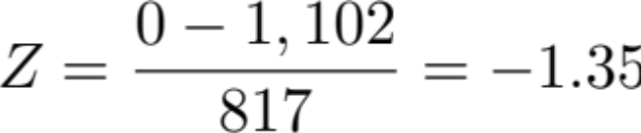
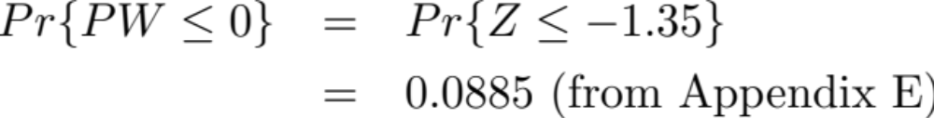
The probability is found by looking up a value in the standard normal table (Appendix E).
So

Slide 23
Another way to handle uncertainty is to use Monte Carlo simulation.
Based on the probability of different outcomes for each random variable, a particular value is randomly generated.
The numbers generated for all random variables constitute an instance or realization reflecting a particular outcome.
Hundreds or thousands of these instances are generated, and these are examined to assist in decision making.
A caution: these will yield long term, average results, and you will be able to see the variation over time. However, your decision may be a one-time decision, so don’t expect the “average” outcome to be your outcome.

Slide 24
Remember Acme Manufacturing and the new CNC machine. The revenues and associated probabilities are given below, and also now the expenses have been given probabilities.
Revenue | Probability
$35,000 | 0.1
$44,000 | 0.3
$50,000 | 0.4
$60,000 | 0.2
Expenses | Probability
$6,000 | 0.1
$8,000 | 0.4
$11,000 | 0.3
$14,000 | 0.2

Slide 25
Using the RAND() function in Excel, and following the probabilities on the previous slide, we generated 1000 revenue and expense values (each using a separate random number for independence), and found the resulting PW for Acme. We found the following useful information (we could discuss a lot more). Not a good deal!
The average PW was -$20,670
The number of positive PW values, out of the 1000 simulated, was 216.

Slide 26
Monte Carlo simulation is very flexible.
The example used a discrete distribution, but there is a way to use any discrete or continuous distribution. If Excel is used, it has several special functions that generate random variates (e.g., NORMINV to generate normal random variates and BETAINV for beta random variates.)
There are many ways to look at the performance of an alternative using Monte Carlo simulation (we examined only two in the previous example). Graphs can be especially valuable.
Generate lots of data, through many trials. When average values converge to a fairly constant amount, you probably have enough data.

Slide 27
Decision trees can be helpful in examining sequential decision problems with outcomes that vary over time.
Break down large problems into a series of smaller problems.
Provide objective analysis that explicitly considers the risk and effect of the future.
A decision tree is built from a series of nodes, where decisions are made (square symbols) or chance outcomes are noted (circle symbols), and branches, which specify outcomes.

Slide 28
Revisiting Acme Manufacturing and their CNC machine decision.
Acme already has a machine they can use that is adequate for their needs. However, they wish to make a decision about their purchase of the new machine. The time horizon is 4 years, and they know that they won’t replace their existing machine if there is only one years of the time horizon remaining. So, they will make a decision today, and at the end of the first and second years regarding the new machine. We assume no chance elements, only a deterministic decision tree. The tree on the following slide depicts the situation. Cash inflows and durations are above the arrows, and capital investments below the arrows.

Slide 29
Acme’s decision tree.
Old: 30k/yr
1 yr
Old: 25k/yr
1 yr
Old: 20k/yr
2 yr
0
1
2
-15k
-20k
-30k
New: 70k/yr
2 yr
New: 70k/yr
3 yr
New: 55k/yr
4 yr

Slide 30
Analyze decision trees from the last decision, backward to the first.
Decision Point | Alternative | Monetary Outcome | Choice
2 | Old | $20k(2)-$30k = $10k | Old
 | New | $70k(2)-$180k = -$40k
1 | Old | $10k+$25k(1)-$20k = $15k | New
 | New | $70k(3)-$180k = $30k
0 | Old | $30k+$30k(1)-$15k = $45k | Old
 | New | $55k(4)-$180k = $40k

Slide 31
Acme should keep their current machine for one more year.
The table reveals that at decision point 2, if Acme still has the old machine, they should keep it.
At decision point 1, purchasing the new machine provides greater return than keeping the old one.
At decision point 0 (today), it is more advantageous to keep the old (current) machine for one more year, given that the best decision at decision point 1 is to get the new machine.
It would be appropriate to include the time value of money, so cash flows should be discounted to the present and the analysis performed again.

Slide 32
Adding probabilities to decision trees.
Most decisions also include chance outcomes, so we use chance nodes.
All alternatives emanating from either a decision or chance node must be mutually exclusive (no more than one may be selected) and exhaustive (contain all possible outcomes).
The probabilities on the branches from a chance node must sum to one (like probability tree diagrams).
The value assigned to a chance node is the expected value of the possible outcomes along each of the branches leaving the node.

Slide 33
Mitselfik, Inc. believes new scheduling software (at a cost of $150,000) will allow them to better manage product flow and therefore increase sales. The projection of increased annual sales (for the next 5 years), and the associated probabilities, are below. The following slide shows the decision tree, and resulting PW at a MARR of 12%.
Increased annual sales | Probability
$75,000 | 0.35
$60,000 | 0.45
$40,000 | 0.15
$30,000 | 0.05

Slide 34
Probability
Sales increase
PW
75,000
$120,360
0.35
60,000
$68,992
0.45
$66,288
New software
0.15
40,000
-$5,808
$68,992
0.05
30,000
-$41,856
$0
Current software
$0

Slide 35
Mitselfik should purchase the software; the expected PW of the investment is $68,992.
The PW of each annual sales increase amount is given in the far right of the tree.
The expected value of the annual sales increase is $218,992 (the sum of the probabilities times the respective PW).
Subtracting the initial cost yields a net PW of $68,992, which is superior to “do nothing” (which is eliminated, signified by the double lines on that decision branch).

Slide 36
How much would we pay to have perfect information about the future?
Perhaps with additional information we might have a better estimate of sales, or exact knowledge of sales (“perfect” information).
The cost of reducing the uncertainty must be balanced against the value.
Perfect information is not obtainable, so the expected value of perfect information (EVPI) is an upper limit on what we would consider spending.
EVPI = the value of the decision based on perfect information minus the value without the information.

Slide 37
Mitselfik could make the right decision with perfect information.
 |  | Decision with perfect information
Increased sales | Probability | Decision | Outcome | Prior decision
$75,000 | 0.35 | Purchase | $120,360 | $120,360
$60,000 | 0.45 | Purchase | $66,288 | $66,288
$40,000 | 0.15 | No purchase | $0 | -$5,808
$30,000 | 0.05 | No purchase | $0 | -$41,856
 |  | Expected Value | $71,956 | $68,992

Slide 38
How much should Mitselfik pay for perfect information?
If Mitselfik had perfect information they would decide not to purchase the software if the increase in sales were $30,000 or $40,000.
EVPI = $71,956 - $68,992 = $2,964.
It is possible to find the expected value of any additional information that is not “perfect.” This is discussed in detail in the text.

Slide 39
Decision trees can be used to assist in analyzing real options.
Real options, similar to financial call options, allow decision makers to invest capital now or postpone all or part of the investment until later.
When a firm makes an irreversible capital investment that could be postponed, it exercises its call option, which has value by virtue of the flexibility it gives the firm.

Slide 40
A good example of postponable investment is a plant addition.
Consider Mitselfik, Inc., which in addition to purchasing software needs to expand the facility. It can complete the entire expansion now at a cost of $7 million, leading to anticipated net cash flows (after tax) of $1.2 million for the next ten years. At an after-tax MARR of 12%, is this an attractive investment?

Slide 41
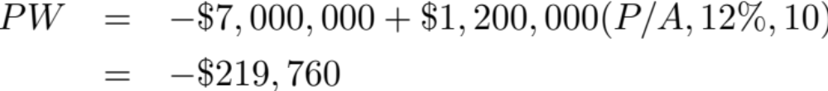
This does not look attractive for Mitselfik.
What if demand should change, rising higher than originally anticipated? Perhaps Mitselfik, Inc. could be prepared and have an option available that would allow them to respond to this increased demand.

Slide 42
Assume that demand could balloon to $3.5 million (or, it could go to zero). The original expansion could handle sales of $1.5 million, and Mitselfik could acquire additional space (an option) to handle the additional increased demand of $2 million at a cost of $4 million. If this additional demand did not materialize, the original expansion could be sold for $1 million. What is the best decision for Mitselfik?
This is modeled as a decision tree on the next slide.

Slide 43
Mitselfik’s decision tree
PW
$9.20mil
Add
$9.20mil
Continue
$1.48mil
Sales $2.1mil
Abandon
-$6.55mil
-$0.22mil
Add
-$3.79mil
Buildingexpansion
Sales $1.2mil
Continue
-$0.22mil
with option
Abandon
-$6.11mil
-$6.11mil
Add
-$10.6mil
Expected value = $0.96mil if all outcomes are equally likely.
Negligible sales
Continue
-$7.00mil
Abandon
-$6.11mil

Slide 44
Mitselfik should strongly consider investing since the option to add capacity can provide a positive return.
Using the decision tree model to assess the option reveals that the expected return, given the best decisions along the way, is $960,000.
However, losses could be large, and there is a 2/3 chance of a loss (if all outcomes are equally likely). Issues like this are covered in Chapter 14.

